Slide 1
Solar gradient blank PPT
Wave option 1

Slide 2
About Me

Slide 3
Agenda
Why Citizen Data Science
PowerBI For Data Science Overview
Pre-Demo Walkthrough
Demo
Post-Demo Wrap-Up
Q&A

Slide 4
Why Citizen Data Science
Citizen Data Science – drivers, not mechanics

Slide 5
PowerBI for Data Science
People know PowerBI as a cool BI tool
Fewer people know it as a neat analytical modeling tool
Fewer people still know it as a tool for data scientists to explore and analyze data and present their results

Slide 6
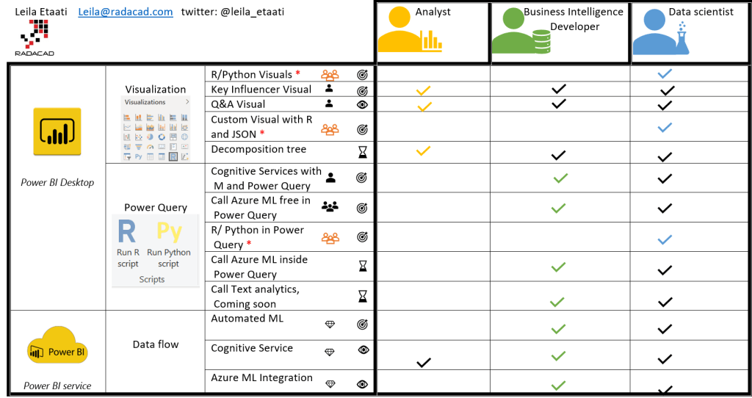
What I’m Going to Show You

Slide 7
Demo

Slide 8
What I Showed You

Slide 9
Questions

Slide 10
Thank you!

